Slide 1
T1A3 - Terminal Application Pet Sitter app
Student ID: CAM012112
Student name: Vanessa Denardin

Slide 2
TABLE OF CONTENTS
TERMINAL APP – FEATURES AND HOW TO USE
LOGIC
DEVELOPMENT PROCESS
CHALLENGES
FAVOURITE PARTS
CODE OVERVIEW

Slide 3
1. TERMINAL APP
The app is a database where a pet sitter can store various information, such as the name and contact of the pet owner, pet’s special needs, dates and to-do lists for the service.
Login screen - user and password
Menu - pet sitter profile, client's info, job (date and tasks to do), exit
Clients' info screen allows to add, edit and delete pet’s info
Job screen allows to add, edit and delete date and task’s list

Slide 4
1. TERMINAL APP – FEATURES
Welcome login
Caregiver and clients (pet’s owners) information
Pet’s details
Job order
Task list for each job order
Log out
EXTRAS
Contact’s list
Mark tasks as completed
Financial management
Availability calendar
Pictures of the pet
Email notifications
Message chat

Slide 5
1. TERMINAL APP – TARGET AUDIENCE
App developed to help a single pet sitter to manage their clients’ pets and tasks data
First version intended to only replace manual data entry from pet sitters, not to be a multi-user system and/or having any financial management
The app will help the professional caregiver to keep records of all the clients with important information and pet’s needs including tasks related to support the pet well-being while the owners are away.

Slide 6
2. LOGIC
User is prompted with a welcome screen and login page for accessing the data
A menu is then shown for selection of actions that could be:
Pet sitter profile
Clients
Jobs
Exit
On the profile page, the user can setup its own information to show on the Job page for future printing out to help pet sitter
Client's page will show a list of all existing clients with possibility of add, edit or delete entries. Further down on client's details, pet's information can also be added, edited or deleted
Job's page will initially list all upcoming gigs for the next 7 days or can also look into all records. Jobs are made up of pet sitter/clients/pets' details and a list of tasks that are required to complete for that order.
All menus always offer the option to go back one menu, return to home or exit application.

Slide 7
3. DEVELOPMENT PROCESS
Prepare GitHub project with Kanban board to keep track of all work required and identified during brainstorms
App flow brainstorm on paper including how screens will look like
Classes including data structure that would be required to save the information that the user needs
CRUD for all classes including a dedicated Database class to convert Hashes into JSON and follow the DRY principle (avoid duplication of code)
App interface to implement all CRUD methods

Slide 8
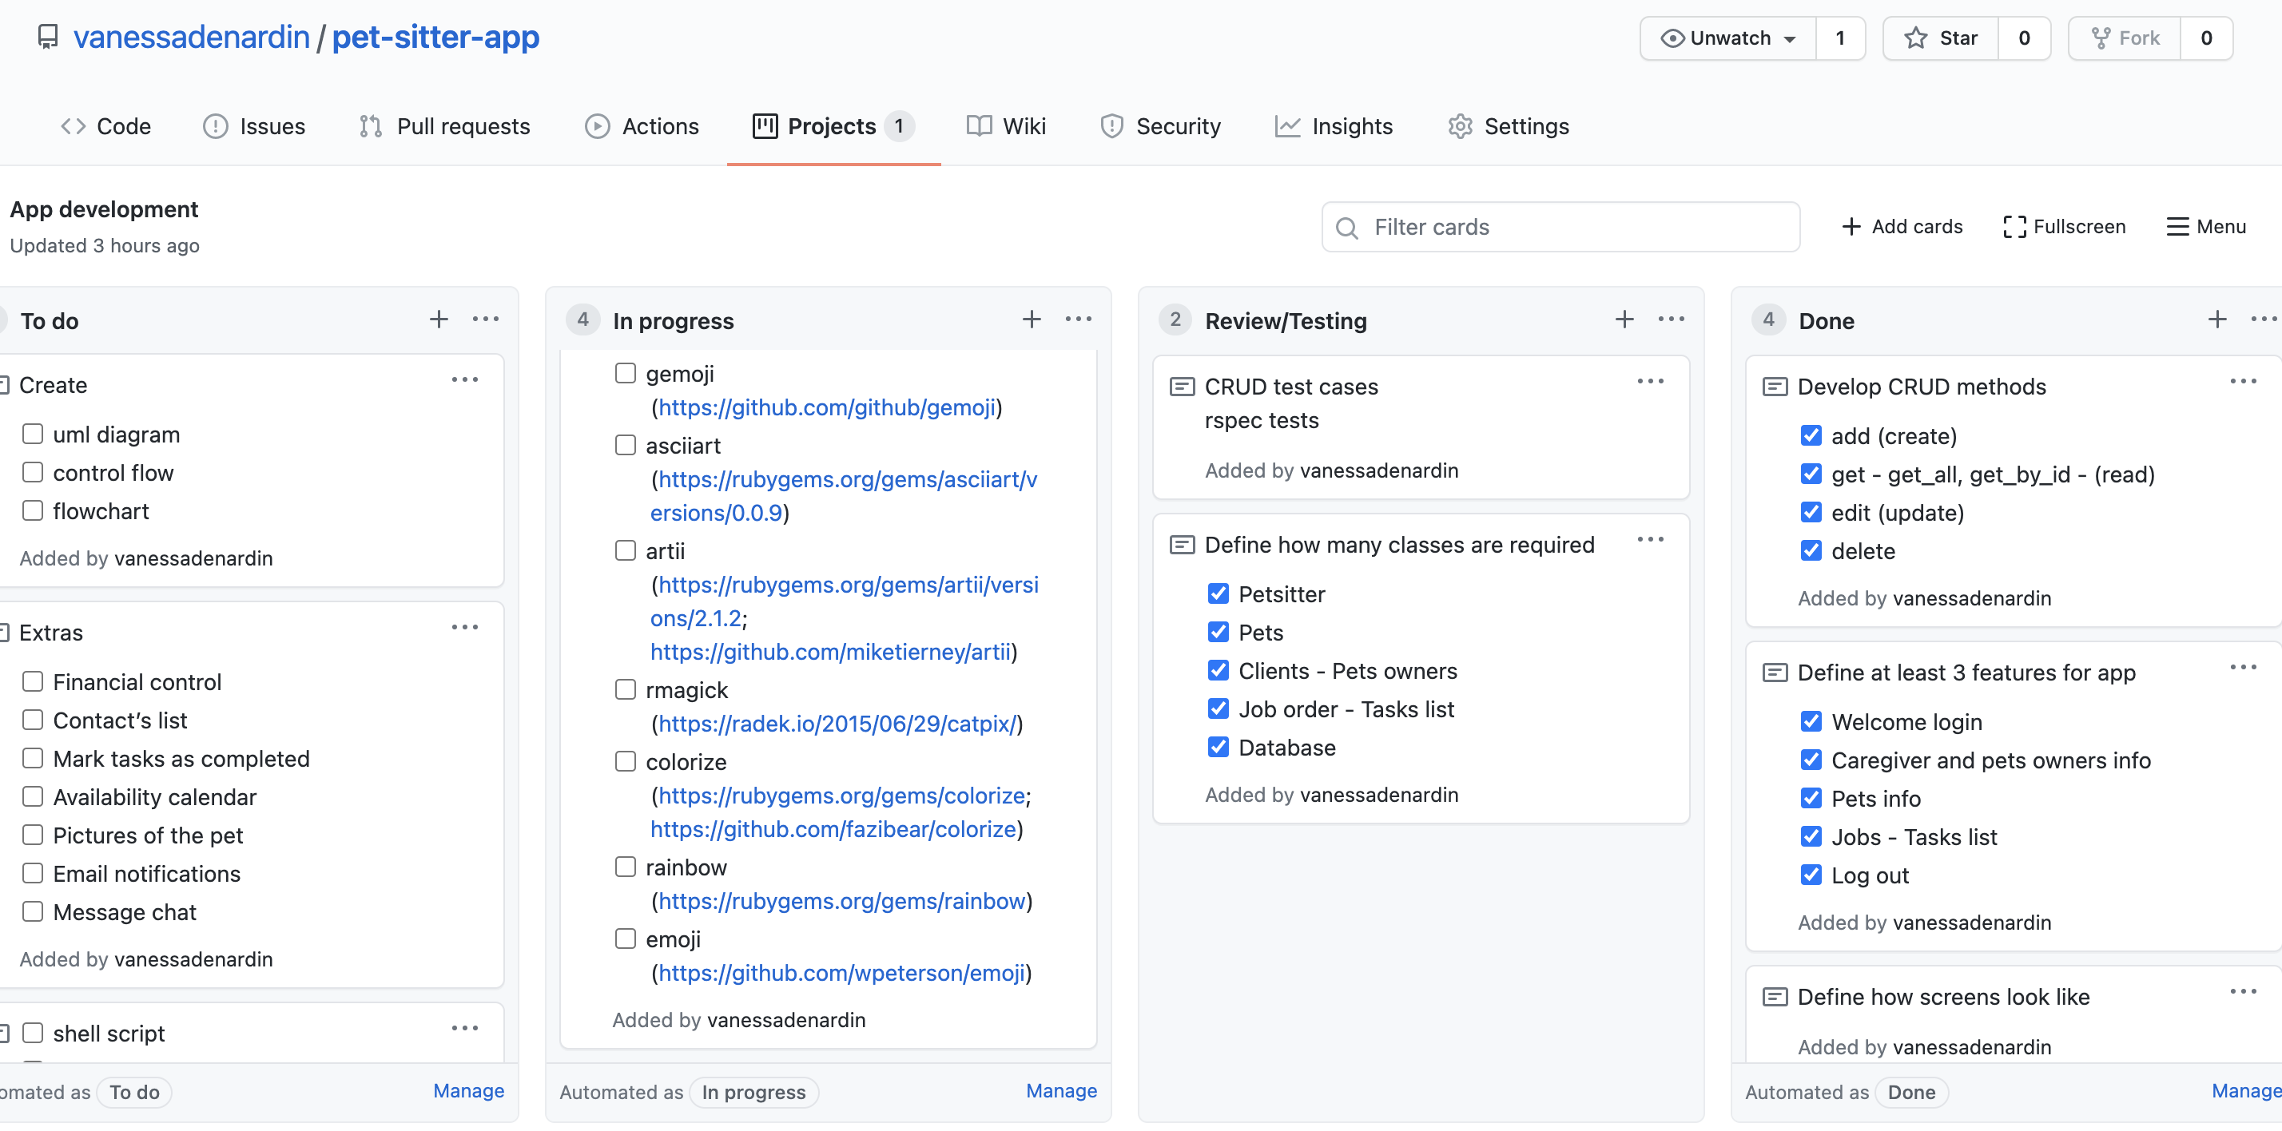
3. DEVELOPMENT PROCESS
https://github.com/vanessadenardin/pet-sitter-app/projects/1

Slide 9
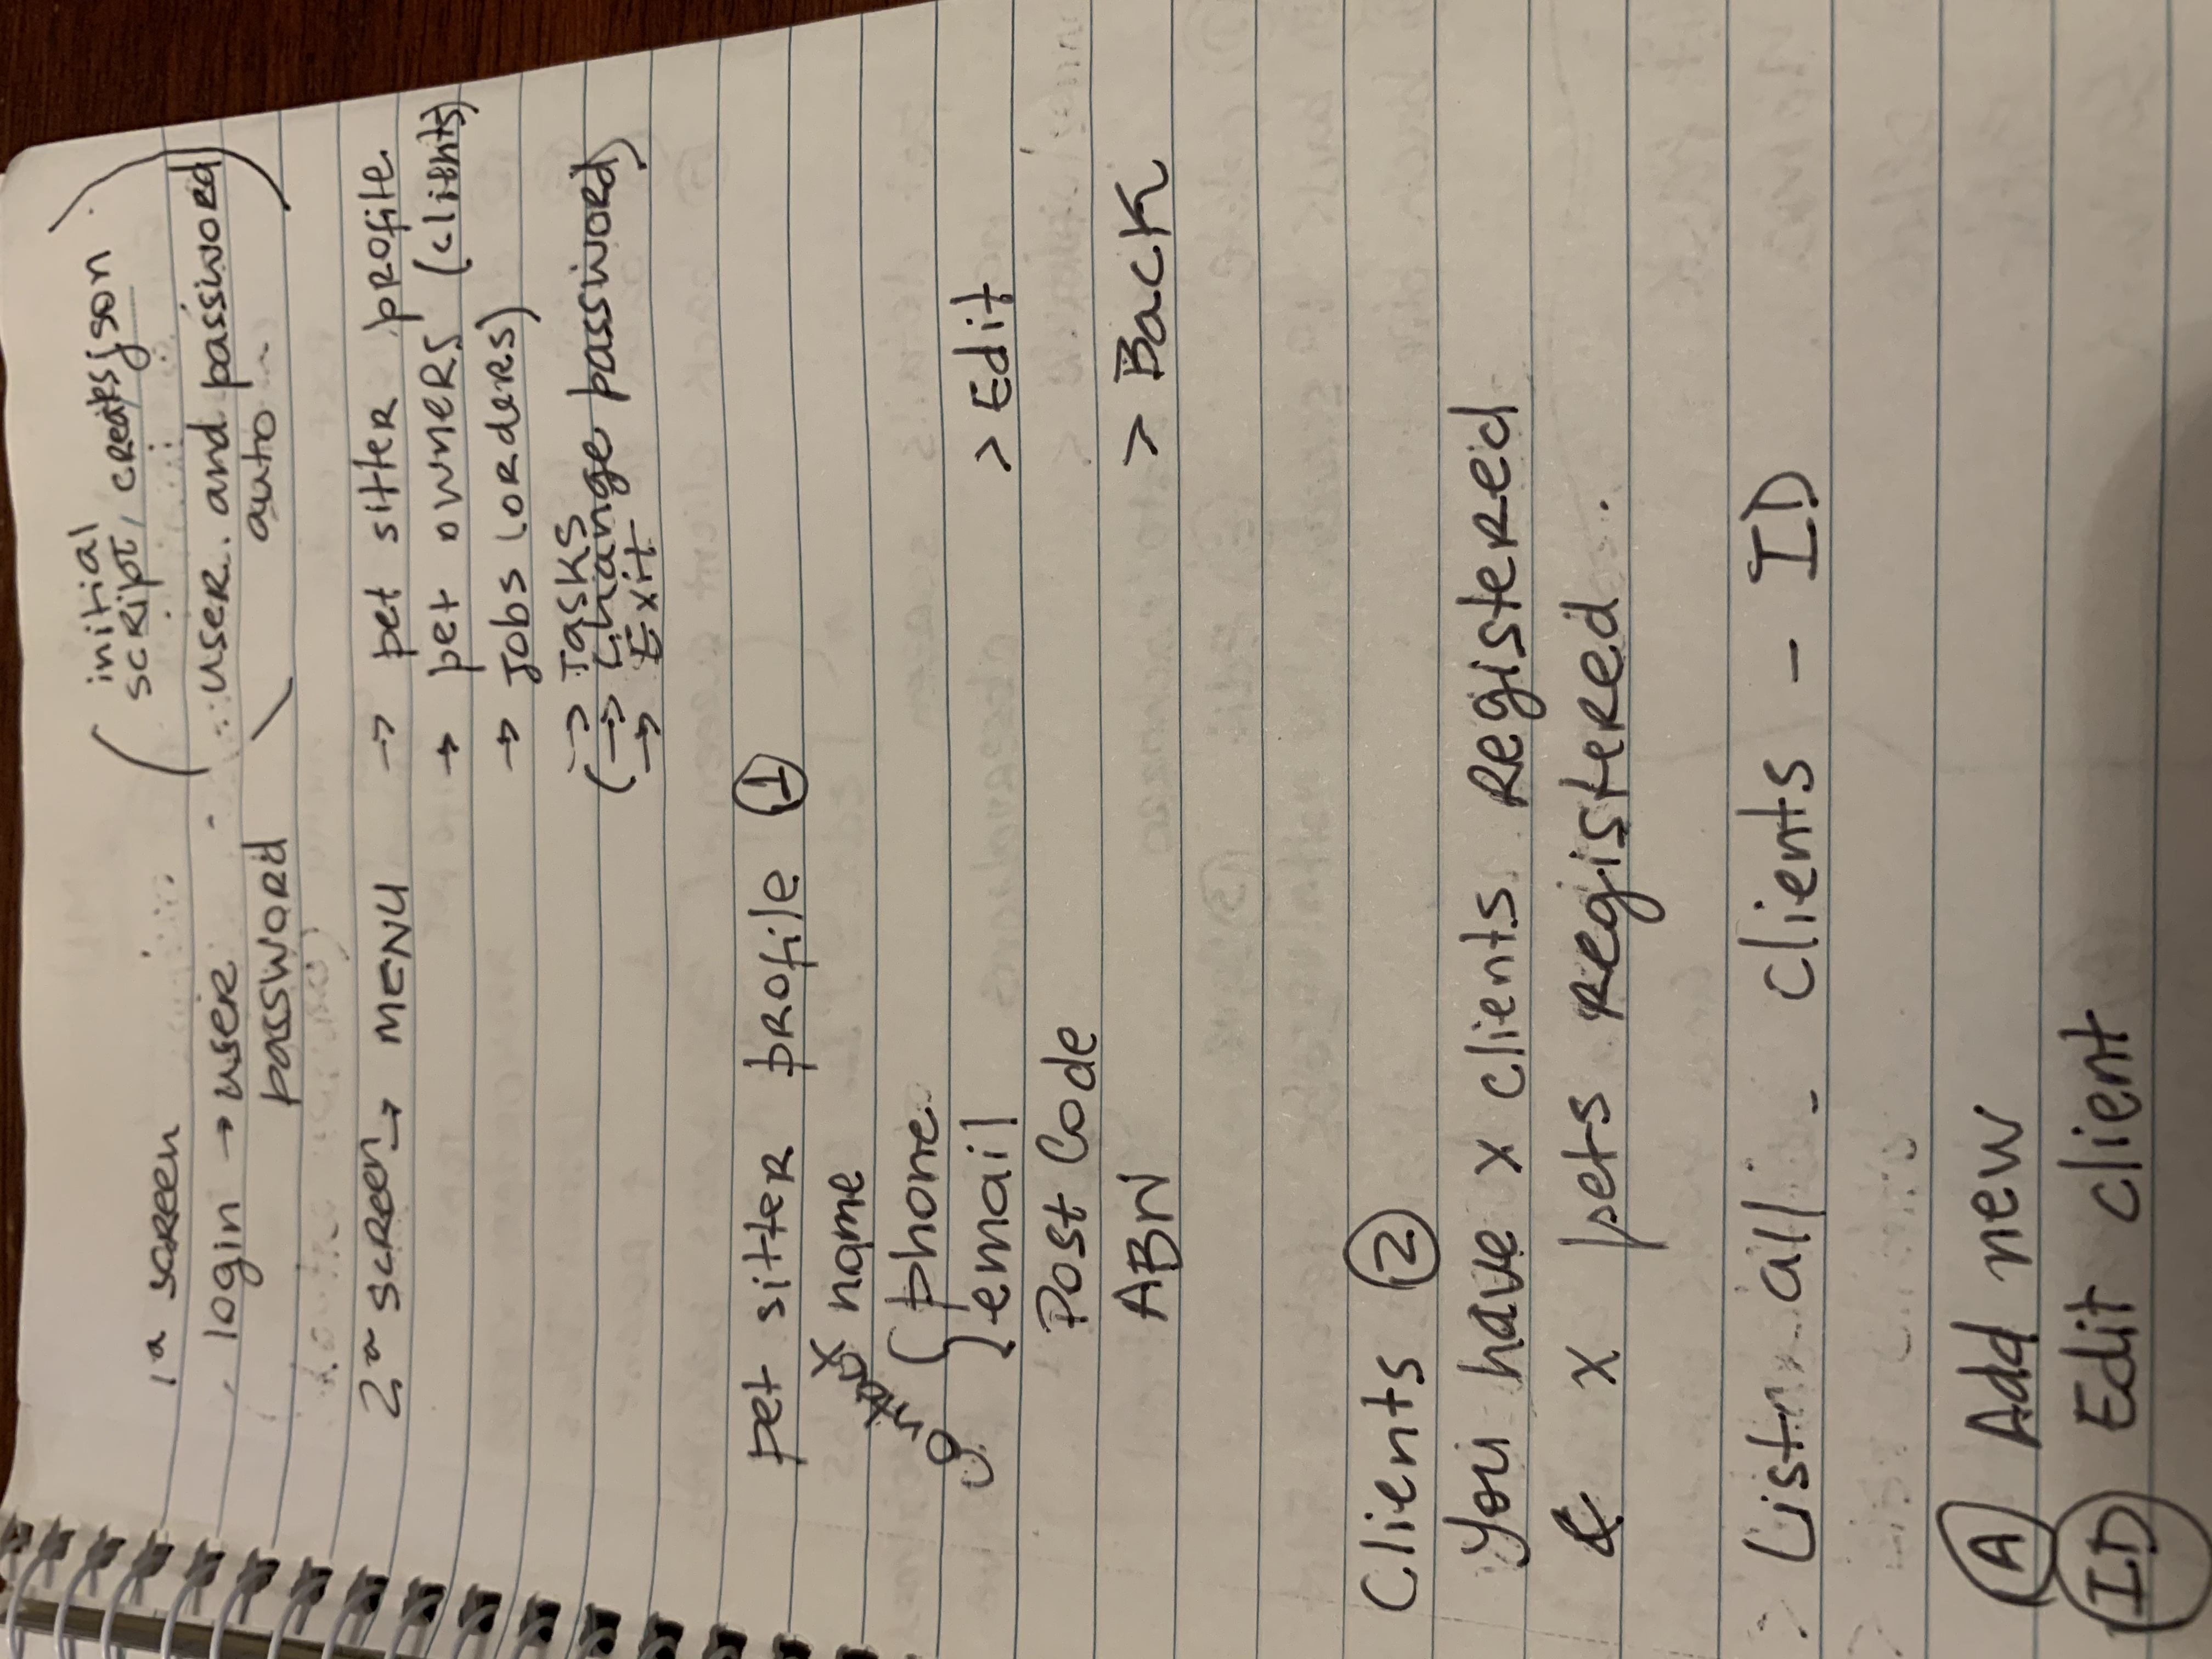
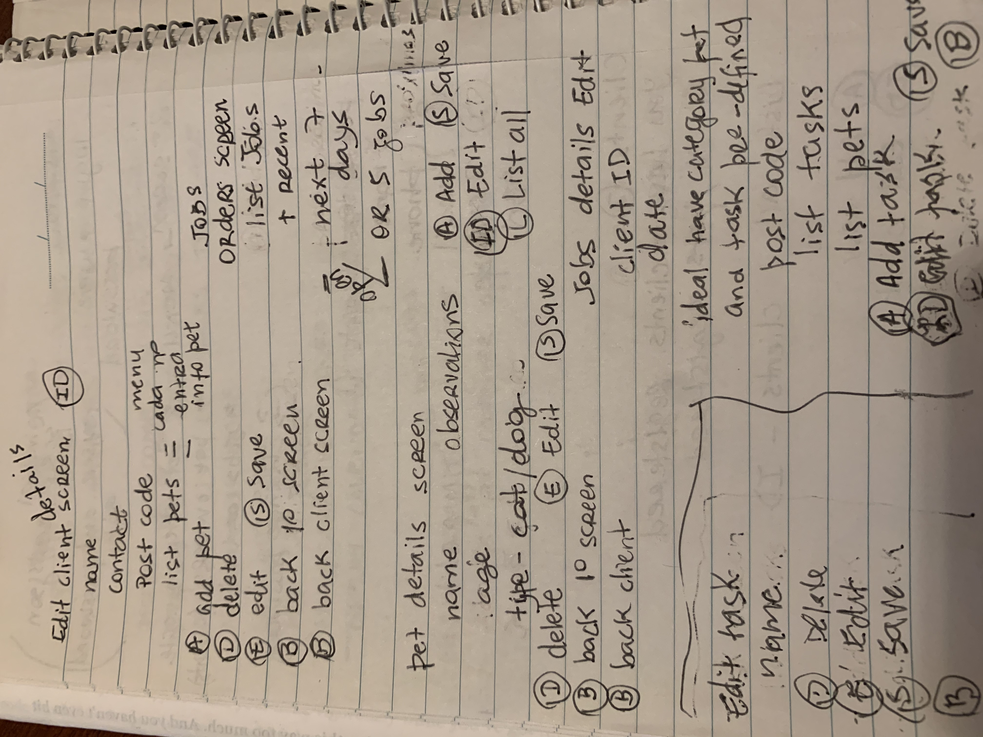
3. DEVELOPMENT PROCESS

Slide 10
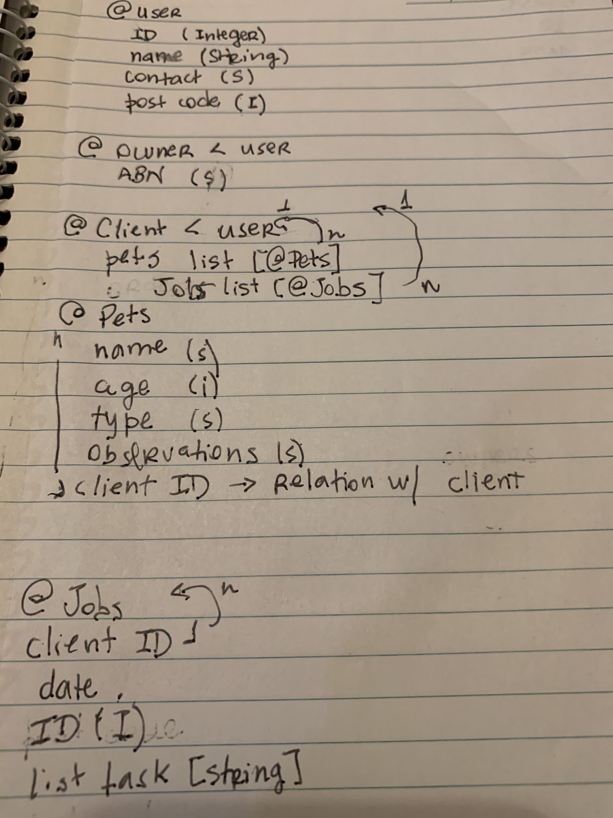
3. DEVELOPMENT PROCESS

Slide 11
3. DEVELOPMENT PROCESS
TODO:
Implement all menu functionality
Improve all unit tests
Create script to setup the application with things like install gems and generate initial json file
Document everything

Slide 12
4. CHALLENGES
Defining classes
Handling errors
Interaction with an external file – data file
DRY code

Slide 13
5. FAVOURITE PARTS
Choosing what to do (brainstorming idea)
Planning app (GitHub Projects)
Designing screens layout
Ruby gems
Overcoming challenges

Slide 14
6. CODE OVERVIEW

Slide 15
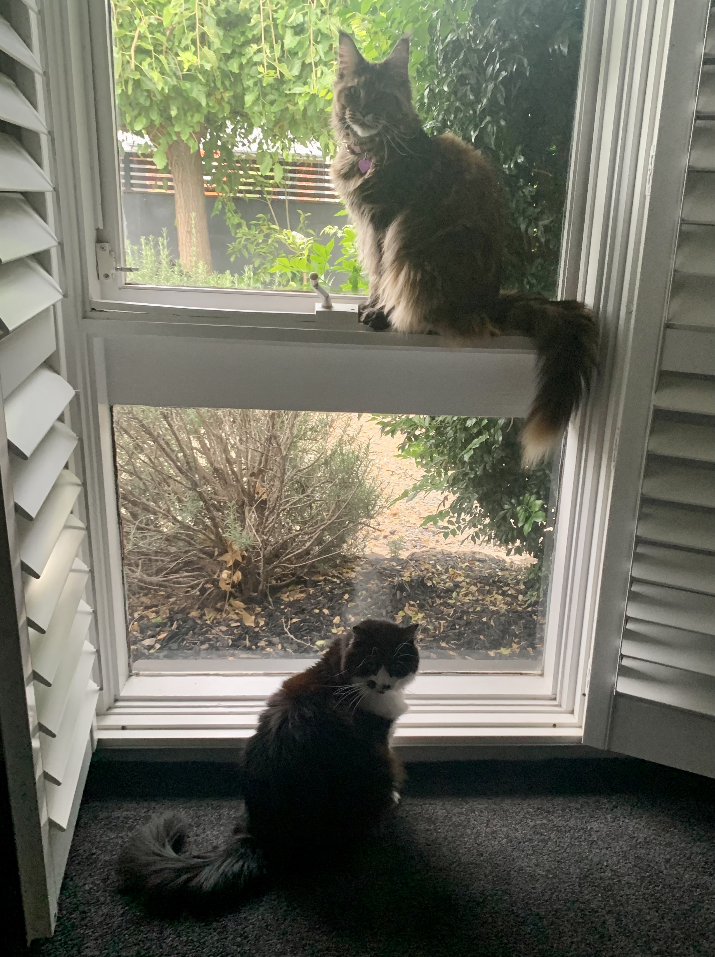
Thank you!

